Slide 1
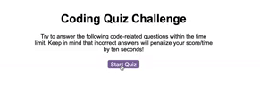
Start Screen

Slide 2
View High Scores
Time:
Here’s question one for you
1 Answer 1
2 Answer 2
3 Answer 3
4 Answer 4
Question screens

Slide 3
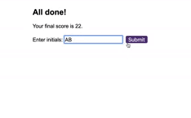
View High Scores
Time:
All Done Screen

Slide 4
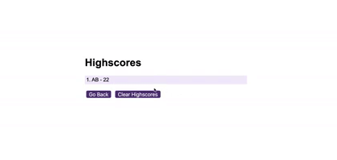
High Score Screen

